Slide 1
Introduction to Text Analysis
Linden Lu

Slide 2
Introduction to Text Analysis
Introduction to text analytics
Text classification
Advanced topics and sentiment analysis

Slide 3
Introduction to Text Analytics
Linden Lu

Slide 4
Introduction to Text Analytic
Text Tokenization
Stop words
Stemming
Bag of Words
Document Term Matrix (DTM)
TF-IDF (Term Frequency–Inverse Document Frequency)

Slide 5
Text Tokenization

Slide 6
Text Tokenization
Tokenization

Slide 7
Text Tokenization
Tokenization
Clean up and unify case

Slide 8
Text Tokenization
Tokenization
Clean up and unify case
Filter stop words

Slide 9
Text Tokenization
Tokenization
Clean up and unify case
Filter stop words
Stemming

Slide 10
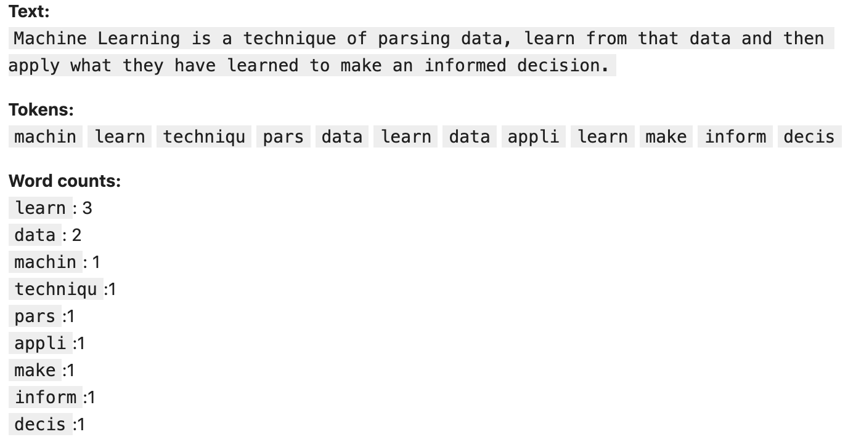
Word Counts

Slide 11
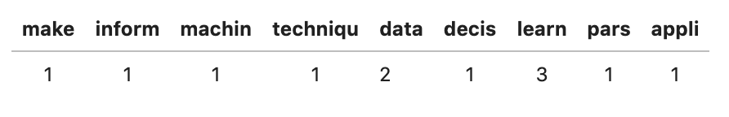
Bag of Words
Document Term Matrix (DTM)

Slide 12
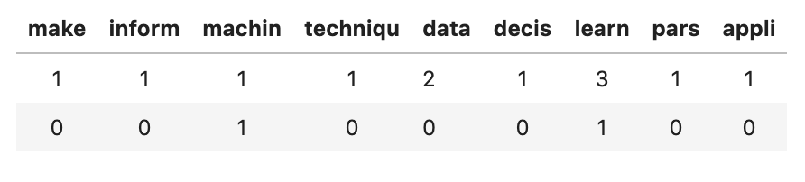
Document Term Matrix (DTM)

Slide 13
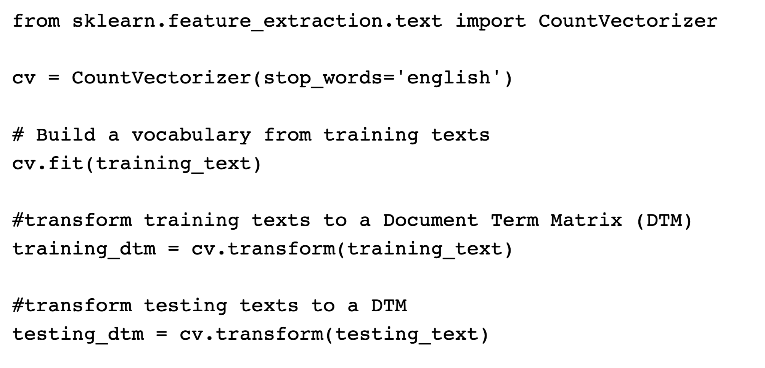
CountVectorizer

Slide 14
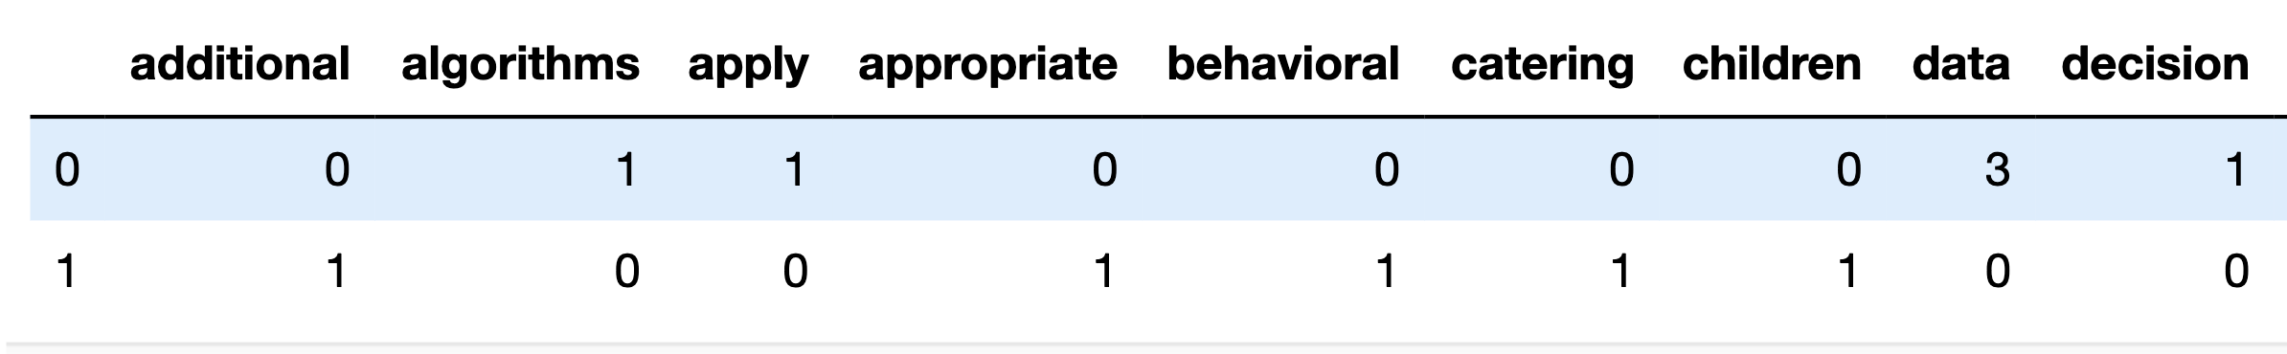
Document Term Matrix(DTM)

Slide 15
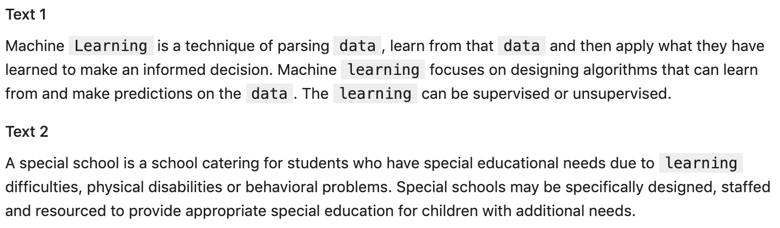
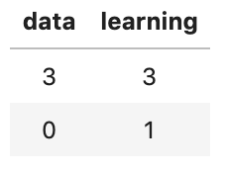
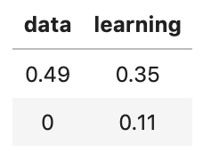
TF-IDF (Term Frequency–Inverse Document Frequency)
Regular DTM
TF-IDF DTM
TF-IDF

Slide 16
Introduction to Text Classification
Linden Lu

Slide 17
Introduction to Text Classification
Data
20 Newsgroup Dataset
Algorithm
Naïve Bayes
Linear SVC
Logistic Regression

Slide 18
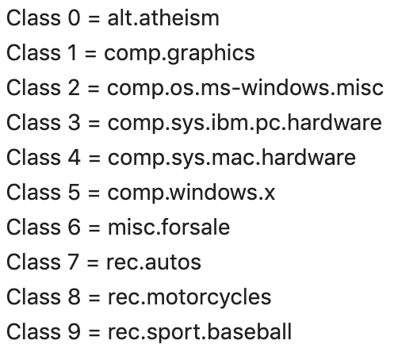
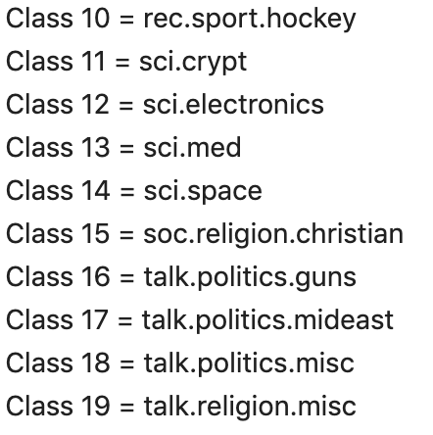
20 Newsgroup Dataset

Slide 19
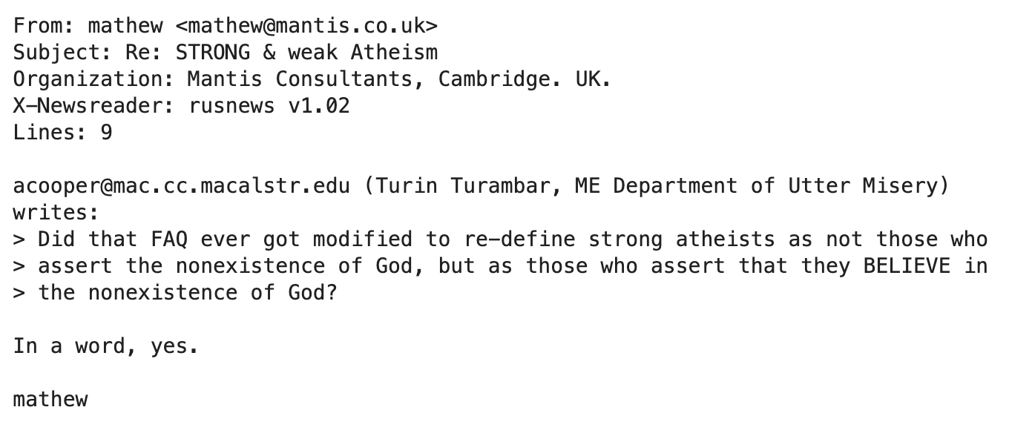
20 Newsgroup Dataset
Sample Message (alt.atheism)

Slide 20
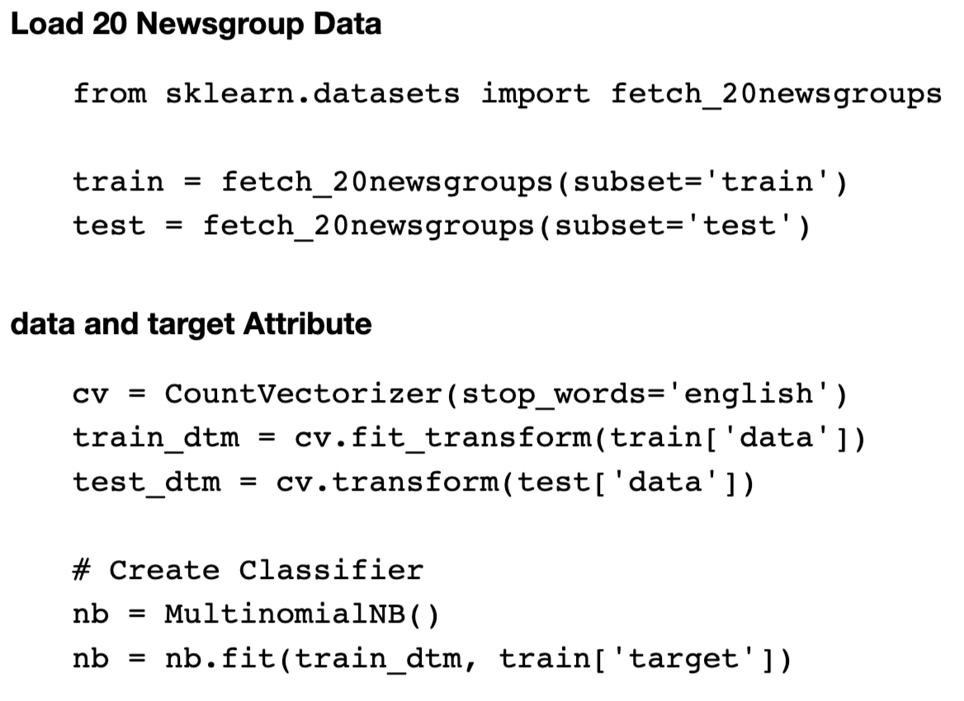
20 Newsgroup Dataset

Slide 21
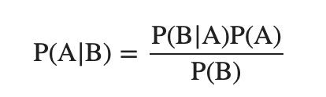
Bayes Theorem
Where A and B are events
P(A) is the probability of observing event A.
P(B) is the probability of observing event B.
P(A | B) is a conditional probability: the likelihood of event A occurring given that B is true.
P(B | A) is a conditional probability: the likelihood of event B occurring given that A is true.

Slide 22
Bayes Theorem
Cancer Screening Test
10,000 cancer screening test results
1% have cancer
80% cancer patients tested positive
5% healthy people tested positive
Question
What's the likelihood of a person to have cancer if tested positive.

Slide 23
Bayes Theorem
1% has cancer: 10000 x 0.01 = 100 have cancer, 9900 don’t
Predicted positive: 100 x 0.8 + 9900 x 0.05 = 80 + 495 = 575
True positive among predicted positive: 80
Probability to have cancer if tested positive: 80/575 = 14%

Slide 24
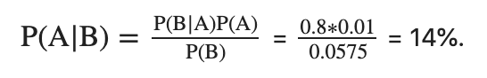
Bayes Theorem
Event A is has the cancer, P(A): 1%.
Event B is test positive, P(B): (80+495)/10000=5.75%.
P(B|A) is the likelihood of testing positive when having the cancer, 80%.
P(A|B) is the likelihood of having cancer when tested positive, or the probability we are trying to find out.

Slide 25
Bayes Theorem on Text Classification
A represents a topic, P(A) is the proportion of all messages that are in topic A.
B represents occurrence of a word B, P(B) is the frequency of the word B in the text.
P(B|A) is the likely frequency of the word B appears in the text if the text belongs to the topic A.
P(A|B) is the likelihood of a text in topic A given the frequency of word B.

Slide 26
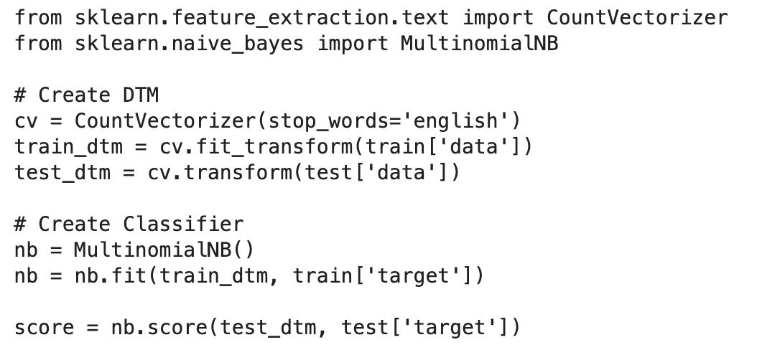
Naïve Bayes Classifier

Slide 27
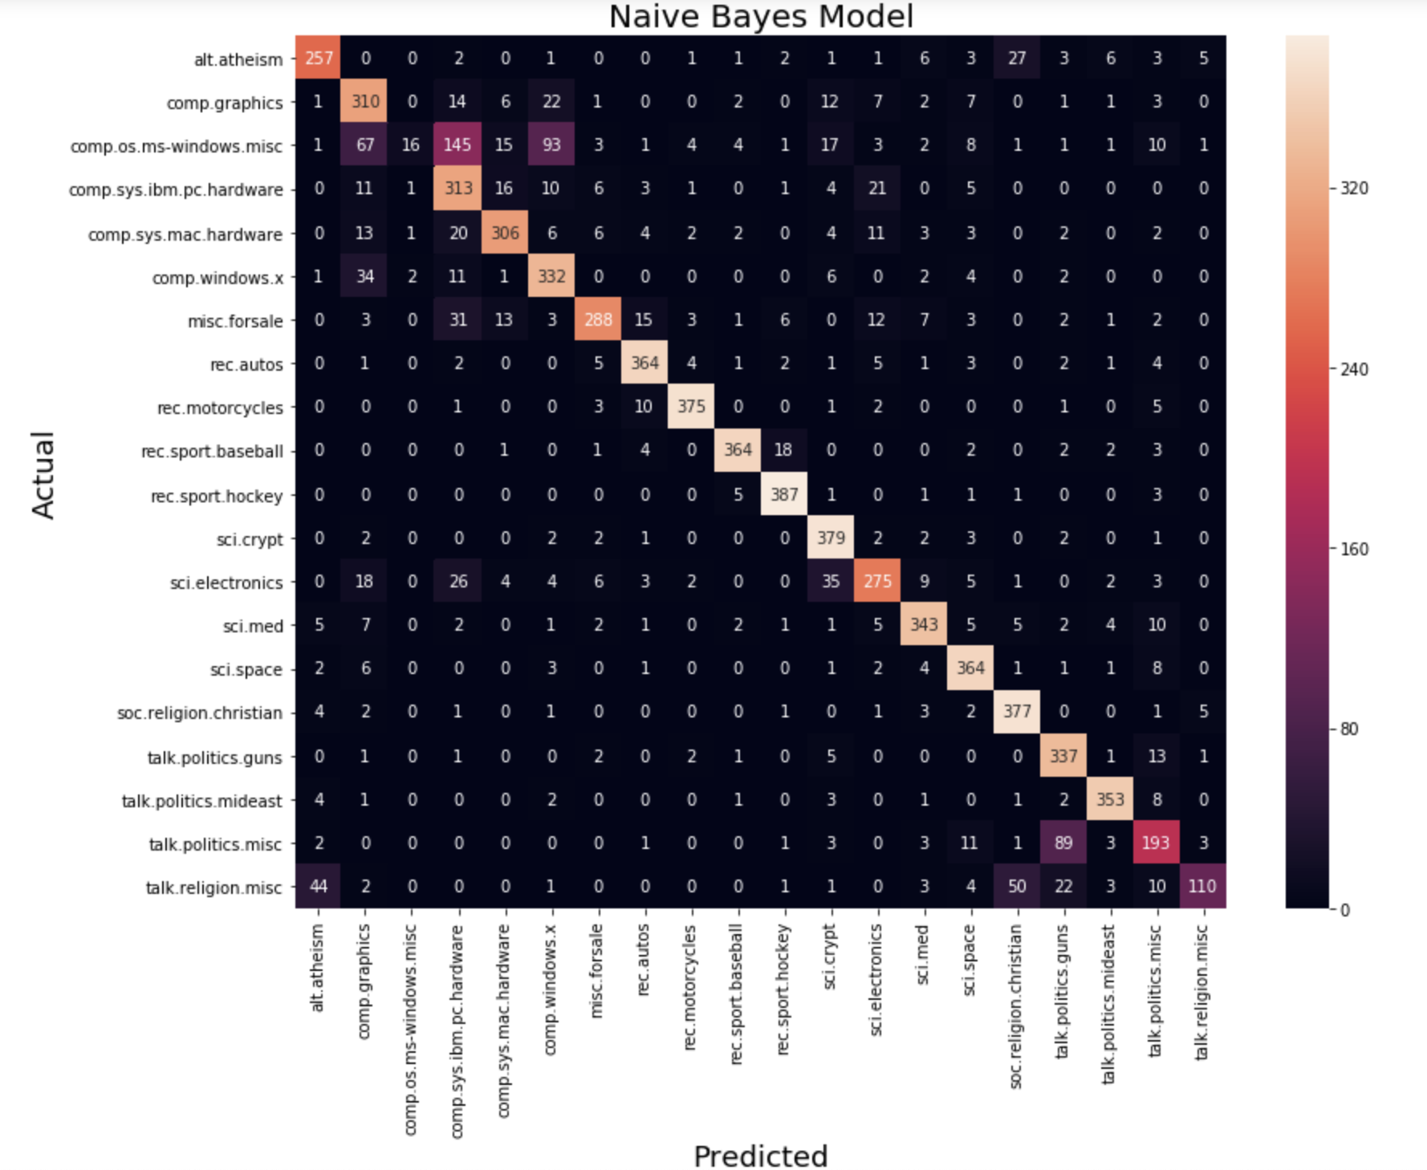
Confusion Matrix

Slide 28
Introduction to Text Classification II
Linden Lu

Slide 29
Introduction to Text Classification II
Explore Classifier
N-grams
N-gram Classification
Sentiment Analysis
Stemming

Slide 30
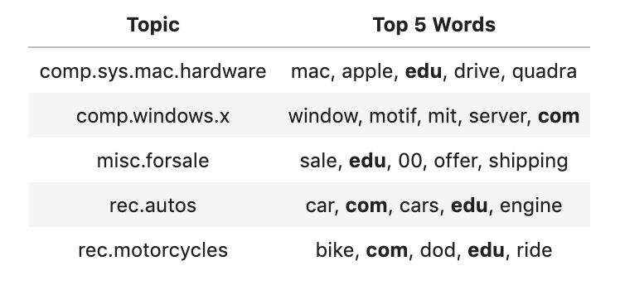
Top Words

Slide 31
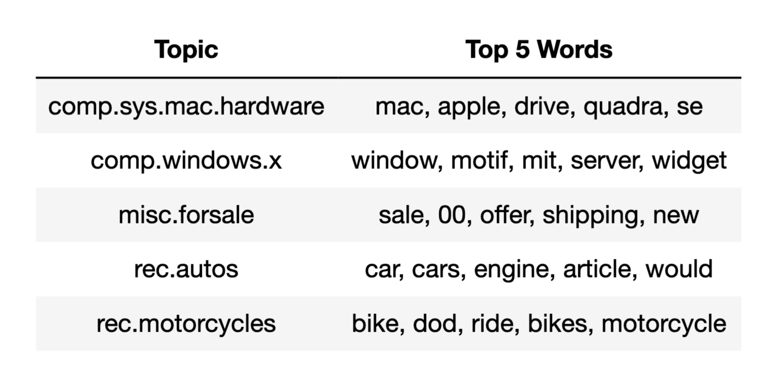
Top Words

Slide 32
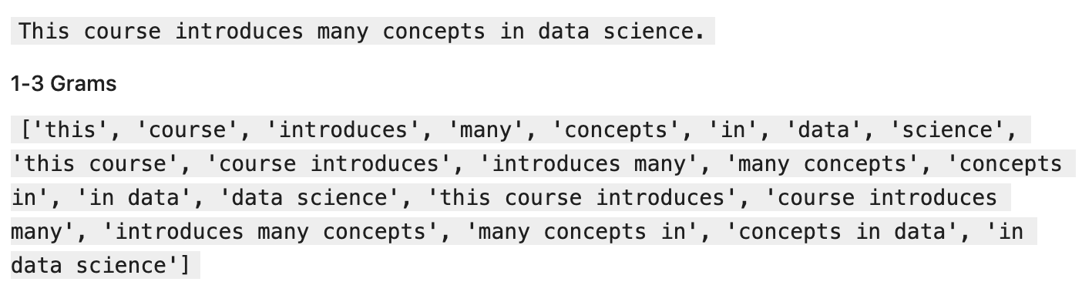
N-grams

Slide 33

Sentiment Analysis

Slide 34
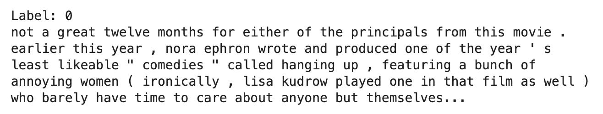
Movie Review Dataset
Built-in in NLTK
2000 movie reviews
1000 positive, 1000 negative
Sample Review (Negative)

Slide 35
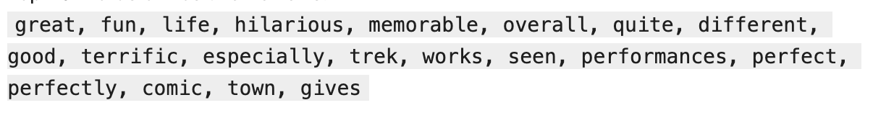
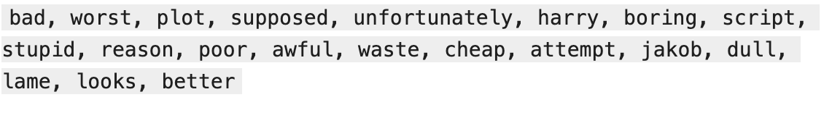
Top Words
Positive Reviews
Negative Reviews

Slide 36
Stemming
Not supported by default
Define custom tokenize function with PotterStemmer
Slow down training process
Improve accuracy

